Slide 1


Info Session: Horizon Results Booster
17th of November 2022
Go-To-Market (GTM) Services (Part II)
Prepared by Anna Franciosini, Ciaotech / PNO Consulting

Slide 2



SERVICE 3: Go-to-Market Support (G2M)
Support Type 4
Support Type 5
Support Type 6
Exploitation
Options
Non-EU
funding
Business Services

Slide 3
Service 3 - G2M
Support Type 4: Business Services
Business Services

Slide 4


G2M Business Service Overview
Service Characteristics
Providing operational support right before entering the market
Solution at high TRL levels
Mature Use Model already available
Advanced KERs developed
Activities included in the service
Preparing commercialization plans for already developed and tested products/services with well-designed exploitation strategies
Assessing feasibility of the business plan to be work on making available a final one
Creating start-ups/spin-offs with complete business model and commercialization plans

Slide 5
GTM Business Service: Types of Support
Types of support 4.1 | Activities | Tools
Co-design commercial development plan | Assessing the desired strategic positioning of the innovation | 4P assessment tool Commercialization plan HRB platform Feedback form
 | Advising/Supporting the optimization of the positioning strategy | HRB platform
Types of support 4.2 | Activities | Tools
Feasibility Study | Examining Business Plan consistency | Business Model Assessment Tool Financial business case assessment Tool HRB platform Feedback form
 | Examining Feasibility and Profitability
Types of support 4.3 | Activities | Tools
Supporting start-up/spin-off creation | Assessing the business proposition plan | Self-assessment questionnaire Belbin Team Role test BOSAT self assessment tool HRB platform Feedback form
 | Supporting Team assessment and internal government definition | Belbin Team Role test
 | Assessing legal and regulatory aspects | AYR © self-assessment tool
 | Supporting the management intangible assets | HRB platform
 | Examining legal framework for company establishement | Feedback form
 | Evaluation of environmental, ethics, quality standards

Slide 6
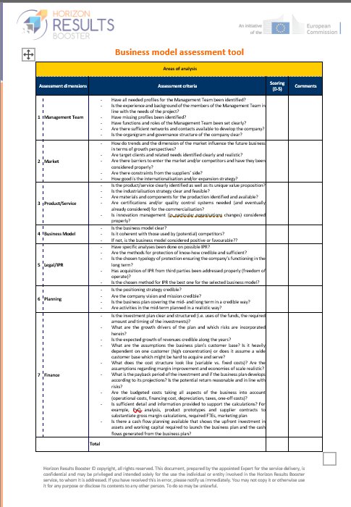
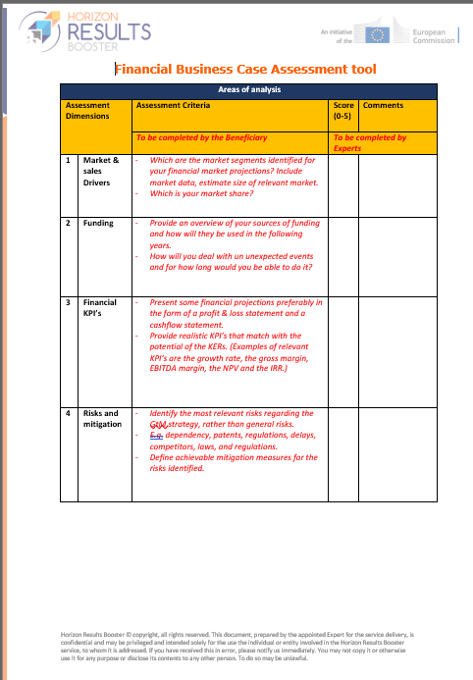
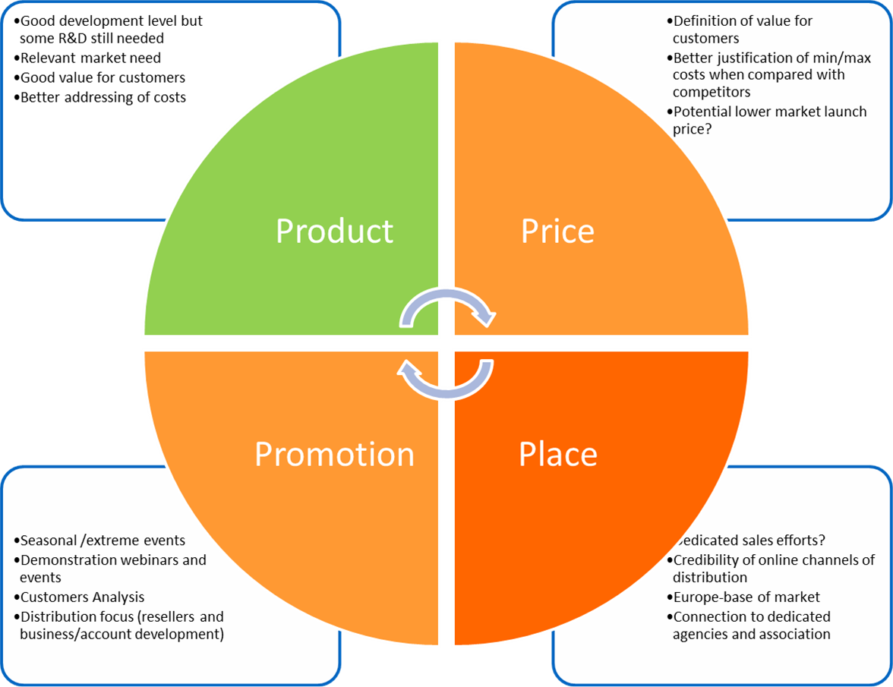
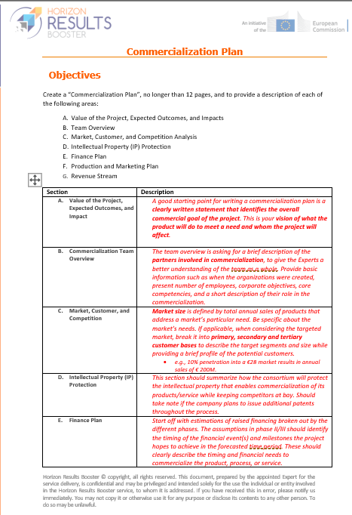
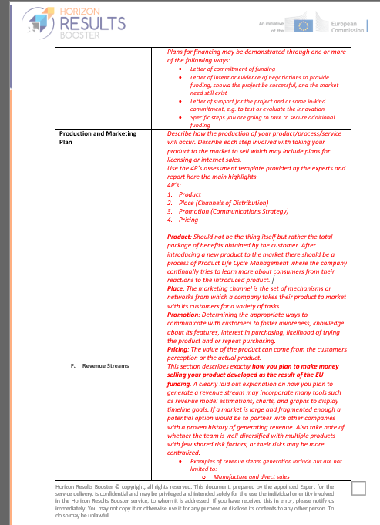
GTM Business Service: tools
4P’s Assessment
Business Model
Assessment Tool
5C’s
Financial Business Case
Assessment Tool
Commercialization Plan

Slide 7
Service 3 - G2M
Support Type 5: Examining Options for Exploitation
Exploitation
Options

Slide 8
GTM Examining Options for Exploitation Overview
Service Characteristics
Support the choice of the right exploitation model for higher impact on markets
Solution at high TRL levels
Mature Use Model already available
Advanced KERs developed
Activities included in the service
Assessing Exploitation Route and Commercialization Strategy
Evaluation of pros/cons of implementation options
Types of support 5 | Activities | Tools
Examining Options for Exploitation | Assessing the Exploitation and Commercialization strategies | KERs Exploitation Form Exploitation Roadmap Form Commercialization Plan HRB platform Feedback form
 | Advising/Supporting the choice of exploitation options | Commercialization Plan

Slide 9
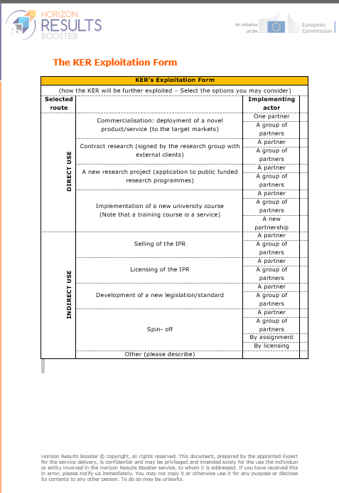
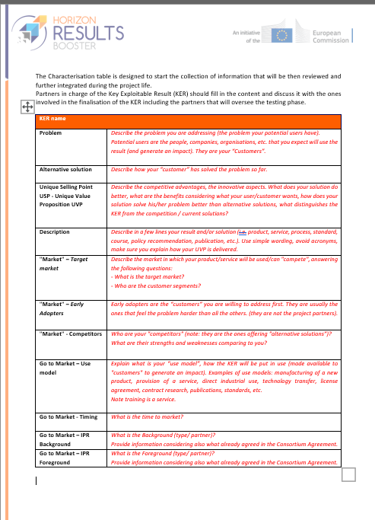
GTM Examining Options for Exploitation: Tools
KER Characterization Form
Commercialization Plan
KER Exploitation Form

Slide 10
Service 3 - G2M
Support Type 6: Access to non-EU Funding
Non-EU
funding

Slide 11
GTM Access to Non-EU Funding Overview
Service Characteristics
Developing thorough public/private funding strategy
Achieve a preliminary conceptualization of an innovative project proposal
Activities included in the service:
Identifying available funding opportunities
Identifying which funding suits beneficiary’s objectives
Understanding how to prioritize different opportunities

Slide 12
GTM Access to non-EU Funding: Types of Support
Types of support 6.1 | Activities | Tools
Project Analysis And Funding Scan | Analysis of funding opportunities facilitating co-financing & G2M process of the specific projects | Feedback form Funding Programme Template
 | Analysis of project’s exploitation or business plan | Funding Programme Template
 | Presentation of funding landscape, opportunities, criteria & requirements
 | Outline of possible funding programmes types fitting the activities/projects to be funded
 | In-depth funding scan
 | 3-hours coaching session on setting up funding strategy
Types of support 6.2 | Activities | Tools
Funding Strategy | Support in the evaluation of identified funding possibilities "pros and cons" | Report on Funding Opportunities
 | Advice on (strategic) prioritization of different funding opportunities
Types of support 6.3 | Activities | Tools
Funding application coaching | Optimization of project application concept, structure, content and argumentation | Project Assessment Form Project Description template
 | Support to application concept development and project positioning | Project Description template
 | Feedback on the proposal and additional input
 | Project qualitative assessment

Slide 13
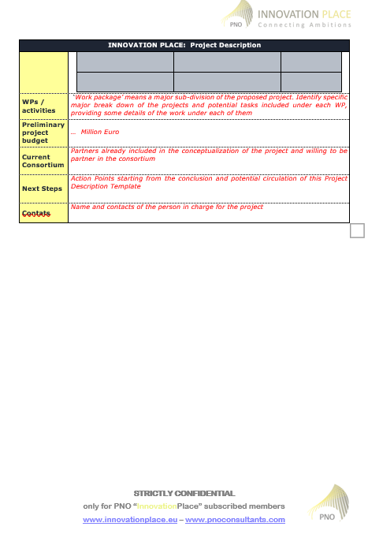
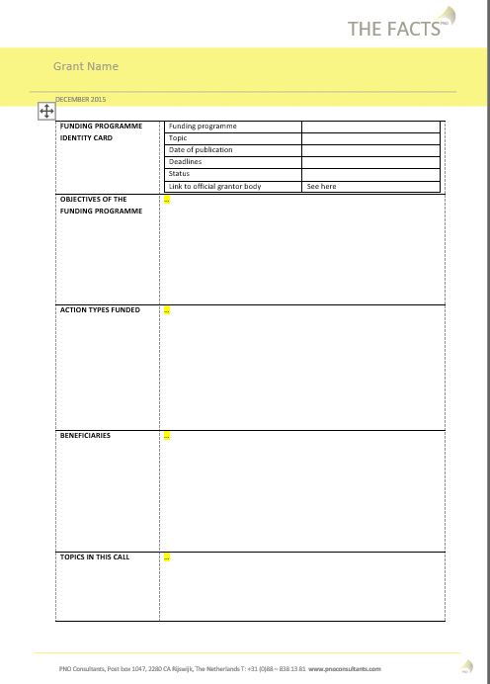
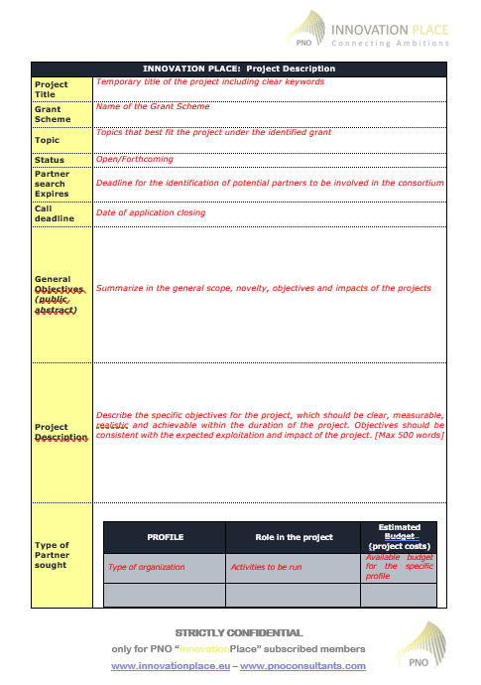
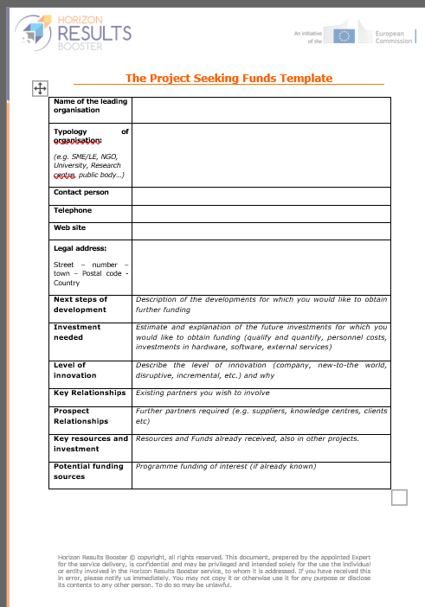
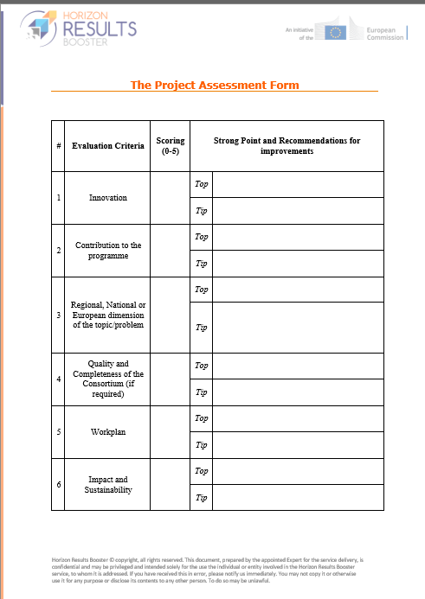
GTM Access to non-EU Funding: tools
Project Description Template
Grant Factsheet Template
Project Seeking Funding Template
Characterization of
Funding Opportunities Form
Project Assessment Form

Slide 14
Anna Franciosini
booster@meta-group.com
www.horizonresultsbooster.eu

Slide 15









AT A GLANCE:
Market driven processing technology and product development to create multiple values for commercial enduser farmers.
Reducing mineral fertilisers & chemicals use in agriculture by recycling treated organic waste as compost and bio-char products
Contribute to the upcycling transformation of organic waste, food industrial by-products and farm organic residues from a costly disposal process into an income generating activity.
FP7- KBBE - Food, agriculture and fisheries, and biotechnology
An EU-27 standardised, advanced, and comprehensive bio-waste treatment and nutrient recovery towards zero emission and energy self sustaining processing performance.
PDESB, PDESC, BPD, G2M
2011 - 2015
3R-BioPhosphate (HU), DLO Plant Research International (NL), SEGES (DK), AGROINNOVA (IT), Gottfried Wilhelm Leibniz Universitaet Hannover (DE), Biomasa del Guadalquivir (ES), WESSLING (HU), KOTO (SI), Municipality of Grugliasco (IT), Renetech Bioresources (IE), Profikomp (HU)
Safe, economical and standardised compost, biochar and BioPhosphate products containing phosphorous and nitrogen that can be economically, lawfully and beneficially used by farmers.
Improve food and environmental safety while generating a new economy model and value chains.
EU policy support to develop legal/technical elements of the EU Fertilising Products Regulation 2019/1009 biochar (CMC14) and compost (CMC3) cases.
Edward Someus, Director 3R-BioPhosphate
www.refertil.info www.BioPhosphate.net

